Slide 1
Project Presentation on AutoQuest (An Intelligent Automatic Question Paper Generator System)
By:
Gaurav Keswani (1501010062) Guided by:
Prateek Kushwaha (1501010097) Mr. Sanjay Pandey
Amir Ahsan (1501010019) Mr. Abhishek Kesarwani

Slide 2
Content:
Abstract
Introduction
Aim
Objectives
Functionalities
Modules
Algorithm
Snapshots
Future Work

Slide 3
Abstract
An Intelligent Question Paper Generator System which generates Question Paper in Portable Document Format(PDF) and Docx Format. In this system we present a smart question paper generating system. In our system we allow administrator to input a set of questions and respective answers for option ticking. We also allow admin to provide weightage and complexity for each of these questions. After this the questions are stored in database along with their weightage. Now on question paper generating time the admin just has to select the percentage of difficulty. On this selection the system selects questions randomly in a way that their weightage makes up for 100 marks and according to difficulty that admin chooses the questions are chosen based on their complexity level. After this question paper is converted to pdf file and emailed to colleges on button click.

Slide 4
Introduction to AutoQuest
Automatic Question Paper Generator is to automate the existing manual system by the help of computerized equipment’s and full-fledged computer software, fulfilling their requirements, so that their valuable data/information can be stored for a longer period with easy accessing and manipulation of the same.
It can assist the user to concentrate on their other activities rather to concentrate on the record keeping.
Thus it will help organization in better utilization of resources. The organization can maintain computerized records without redundant entries.

Slide 5
Objectives:
The main objective of the Project on Automatic Question Paper Generator is to manage the details of
Branch, Course, Difficult Level, Question, Semester. It manages all the information about Branch, Subject, Semester, Course.
The project is totally built at administrative end and thus only the administrator is guaranteed the access.
The purpose of the project is to build an application program to reduce the manual work for managing the Branch, Course, Subject, Difficult Level.
It tracks all the details about the Difficult Level, Question, Semester.

Slide 6
Aim of Project:
The aim is to automate its existing manual system by the help of computerized equipment’s and full-fledged computer software, fulfilling their requirements, so that their valuable data/information can be stored for a longer period with easy accessing and manipulation of the same. Basically the project describes how to manage for good performance and better services for the clients.
To increase efficiency of managing the Branch, Course.

Slide 7
Functionalities provided by AutoQuest:
Provides the searching facilities based on various factors. Such as Branch, Difficulty Level, Question, Semester.
Automatic Question Paper Generator also manage the Subject details online for Question.
Details, Semester details, Branch.
It deals with monitoring the information and transactions of Question.
Manage the information of Branch.
Editing, adding and updating of Records is improved which results in proper resource management of Branch data.
Manage the information of Question
Integration of all records of Semester.

Slide 8
Modules of Automatic Question Paper Generator:
Branch Management Module: Used for managing the Branch details
Semester Module : Used for managing the details of Semester
Subject Module: Used for managing the details of Subject
Course Management Module: Used for managing the information and details of the Course
Difficult Level Module : Used for managing the Difficult Level details
Question Module : Used for managing the Question Information
Login Module : Used for managing the login details
Users Module : Used for managing the users of the system

Slide 9
Algorithm

Slide 10
Start
Create Question Bank
Create list easy[], medium[], hard[]
Randomize an integer n
For each value of easy[] in i:
For each value of medium[] in j:
For each value of hard[] in k:
true
If n=easy[i]
true
If n=hard[k]
false
If n=medium[j]
false
true
false
Add to list
Add to list
Add to list
Get Corresponding question from DB
Get Corresponding question from DB
Get Corresponding question from DB
Generate Paper

Slide 11
SNAPSHOTS

Slide 12
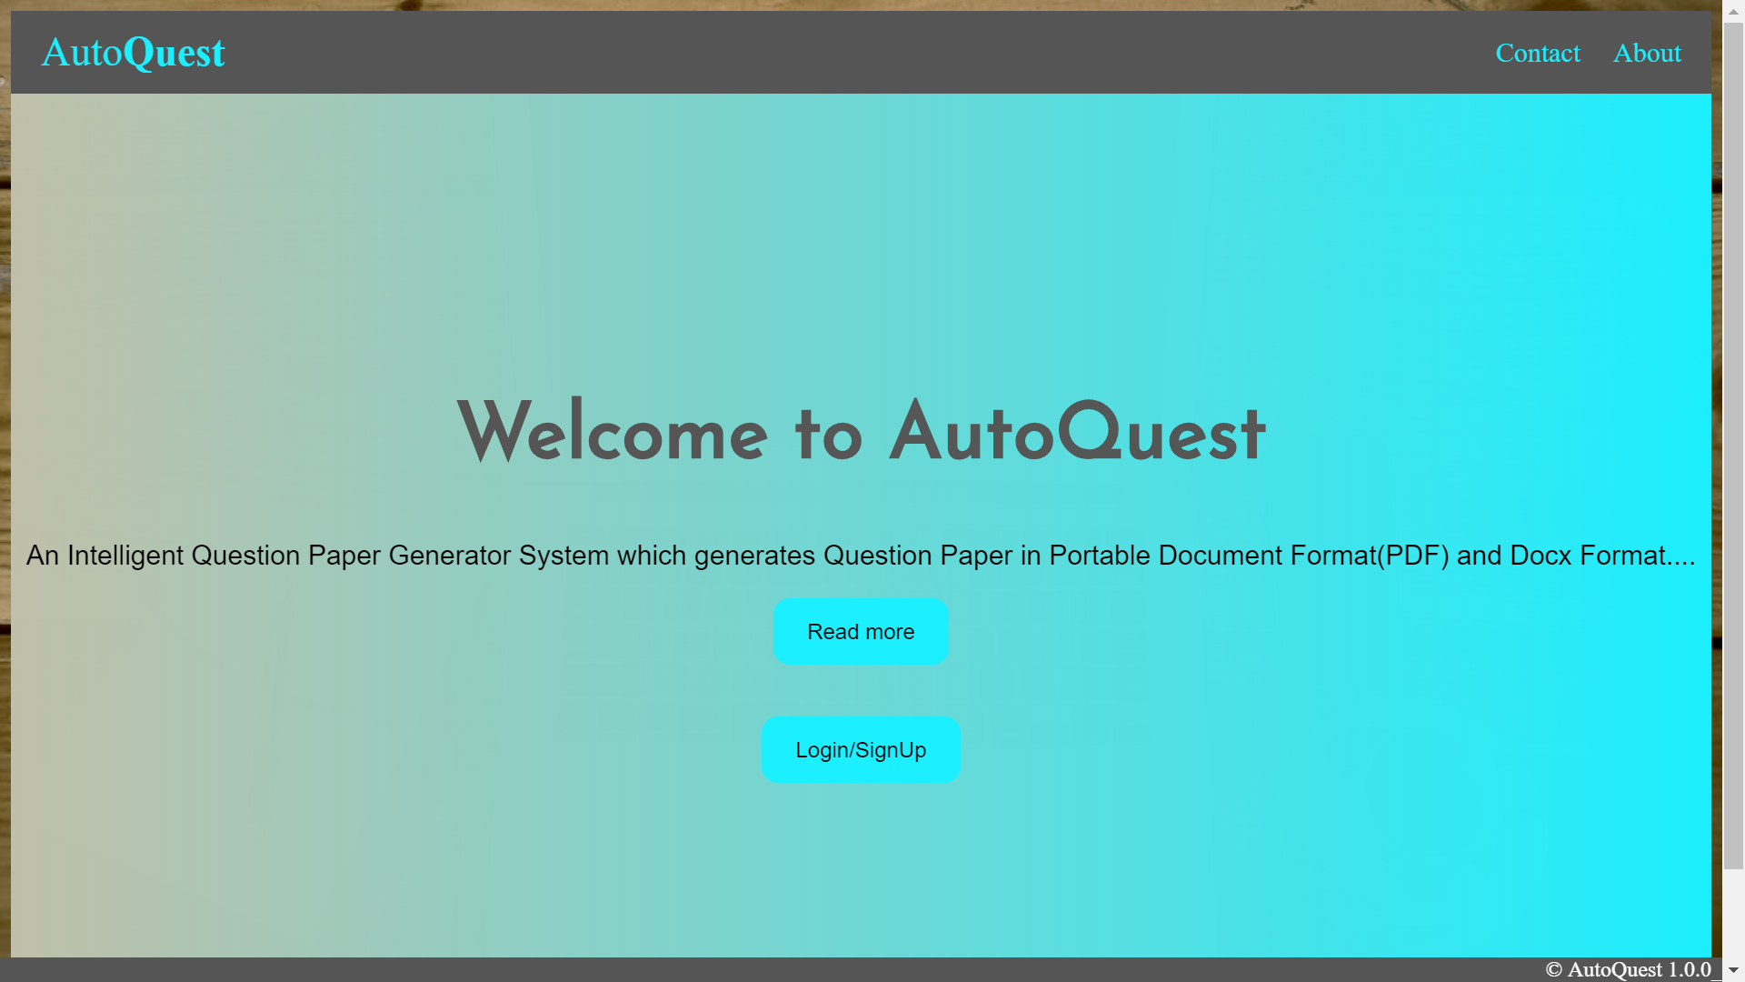
Getting Started

Slide 13
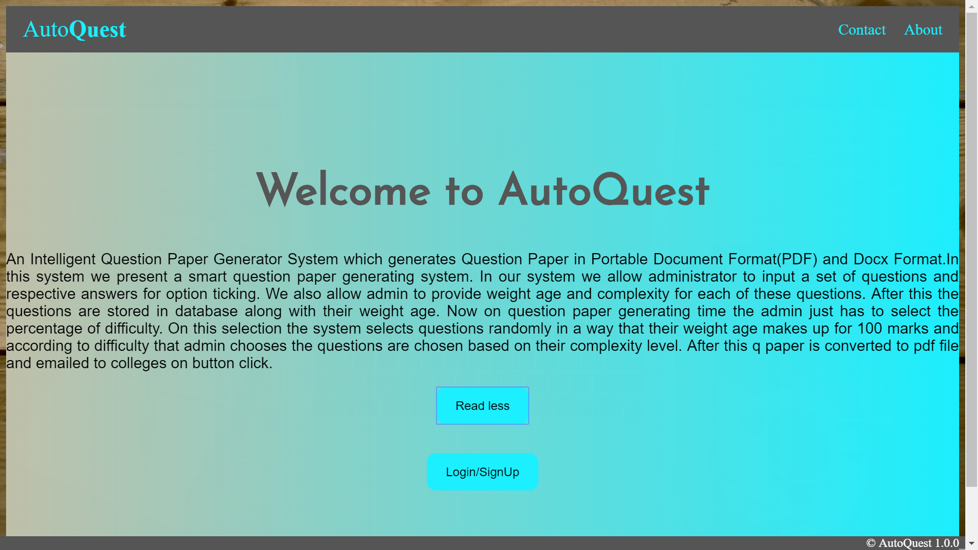
View more about AutoQuest by clicking on Read more

Slide 14
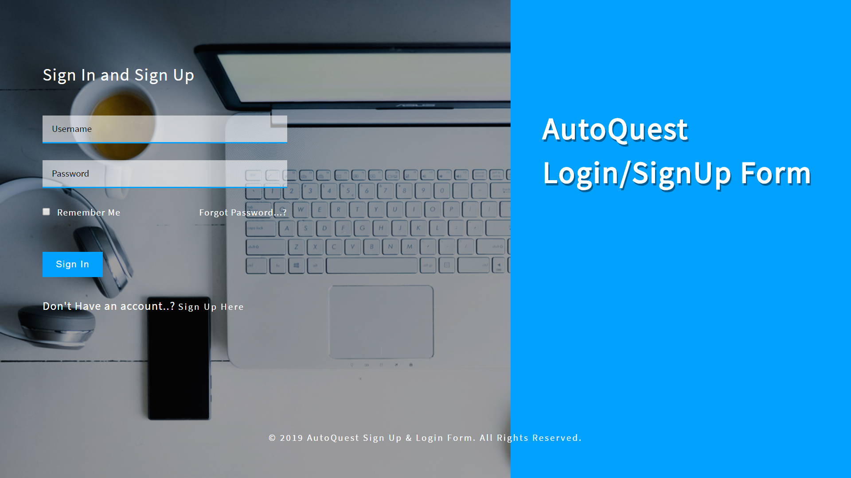
Login/Signup Design

Slide 15
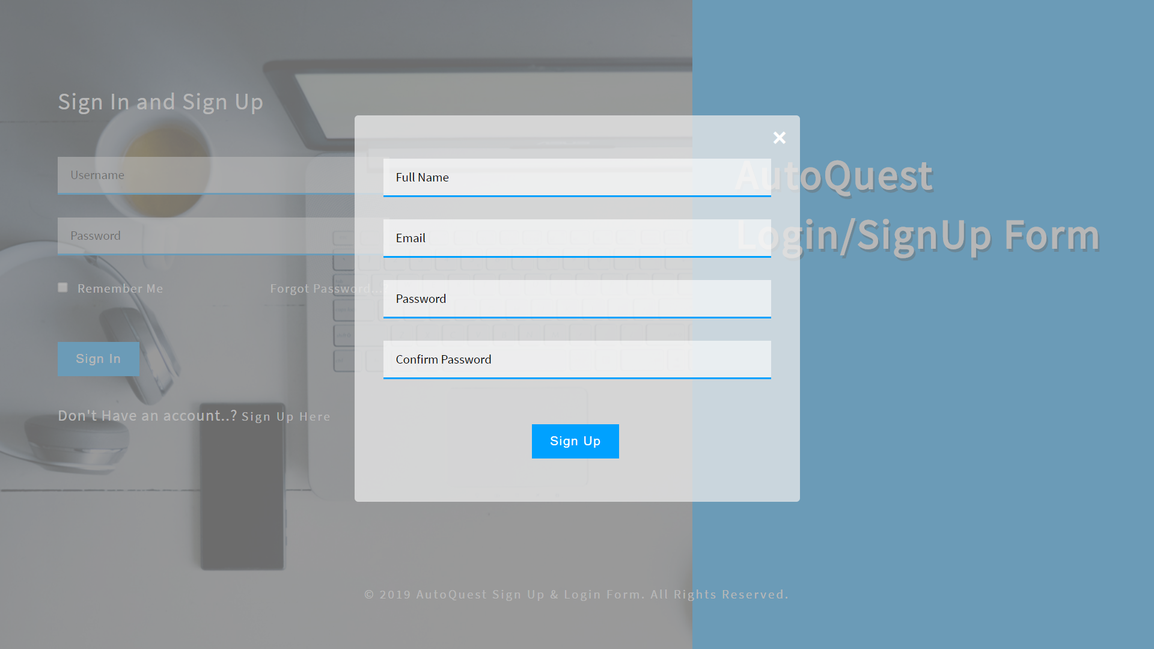
Signup Form

Slide 16
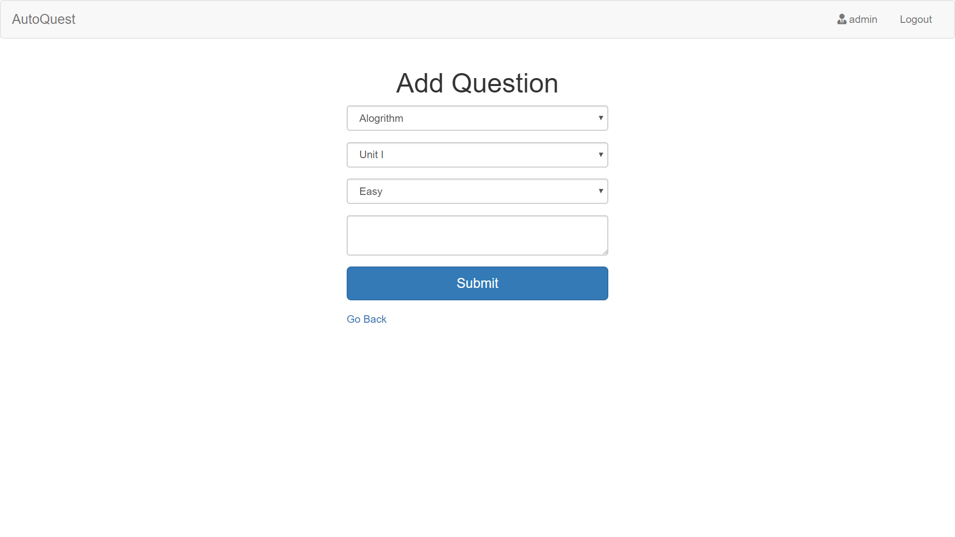
Add Question Interface Design

Slide 17
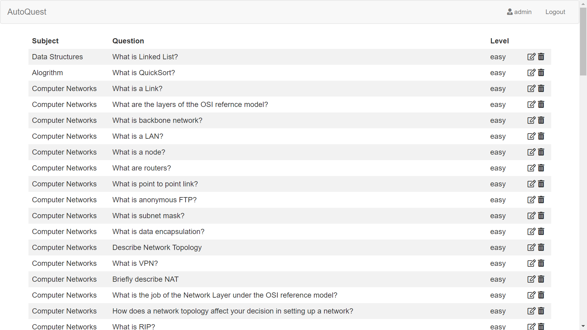
Added Questions View

Slide 18
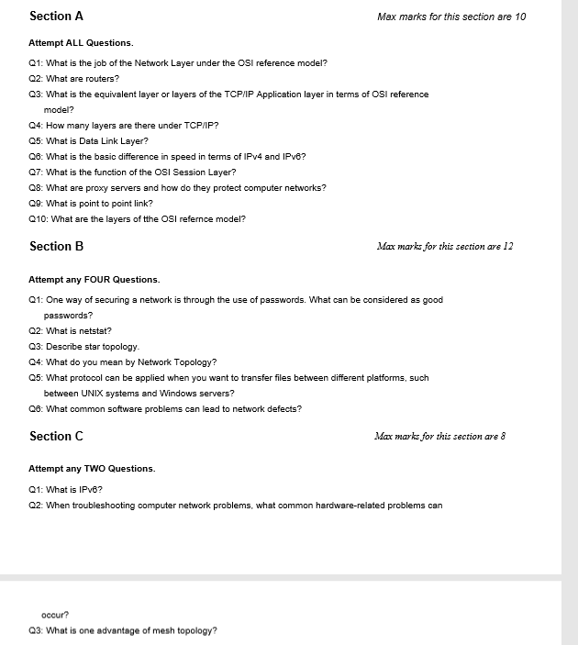
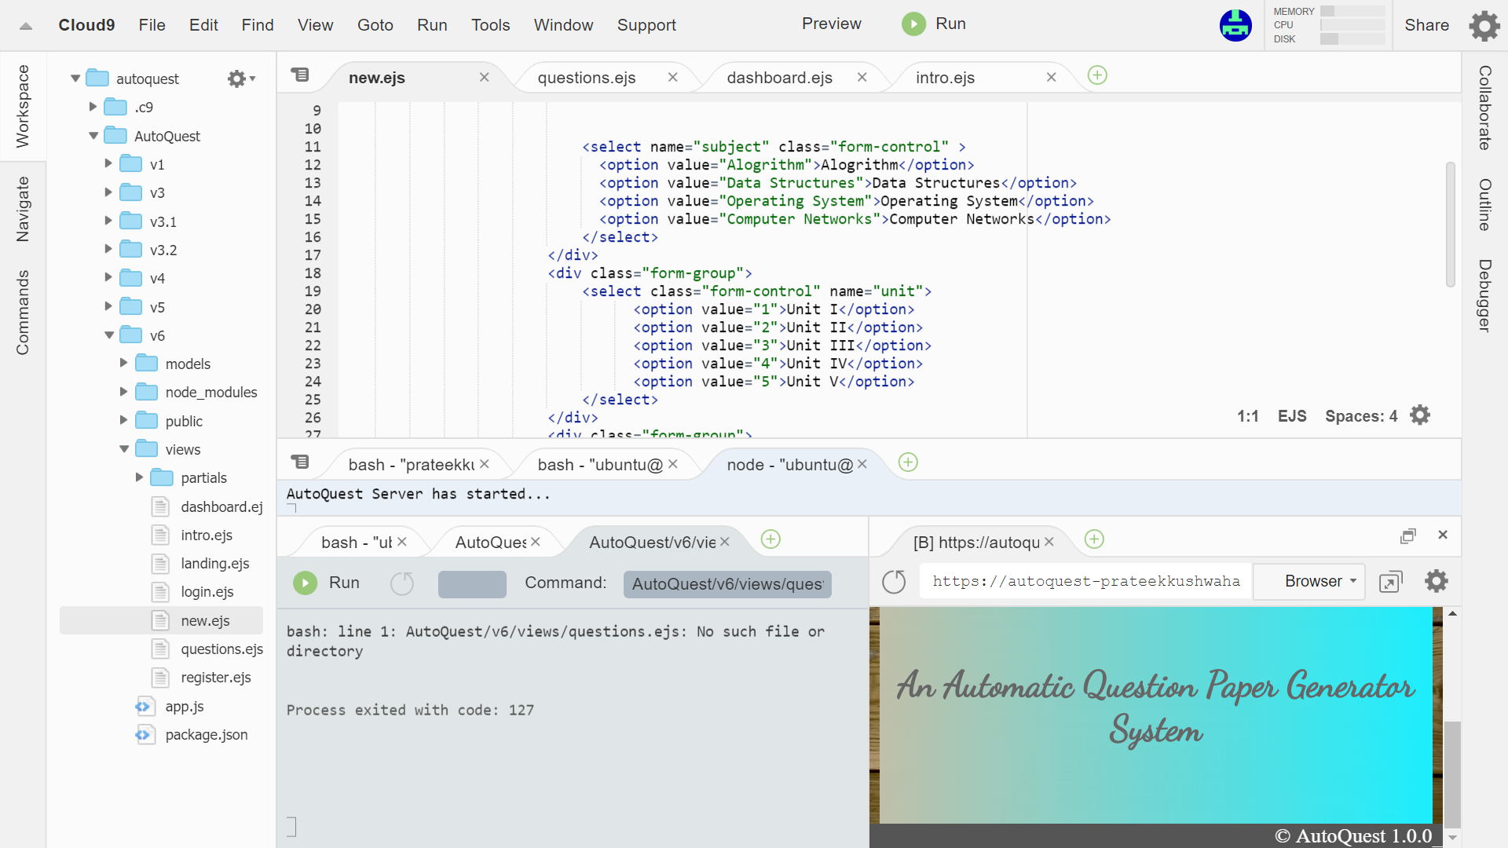

Slide 19
Future Work
In future enhancements, more features will be included to generate questions paper for online and offline MCQ examination. This will help in the cases where the examination pattern consists of only MCQ questions. This eliminate the problem of paper leak cases in the prestigious examinations. Thus, making the examination process more effective and secure.
In future version of AutoQuest there will be facility for uploading question through an image of the questions and questions can be added in batch to the question bank. Therefore, there will be more ease for the user in uploading question to the database.

Slide 20
Thankyou

